Slide 1



UNIT 5
My home and healthy living
Look back 5

Slide 2
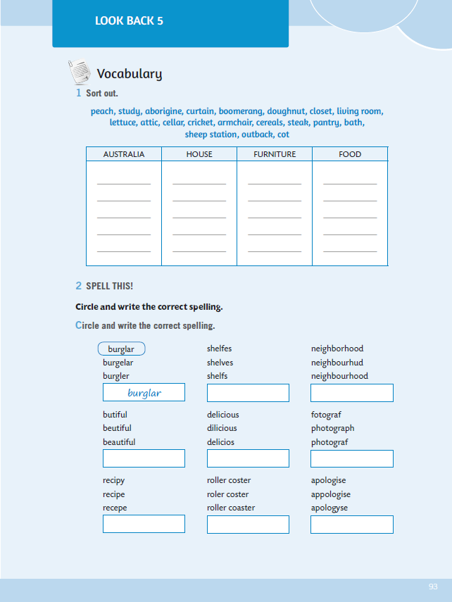
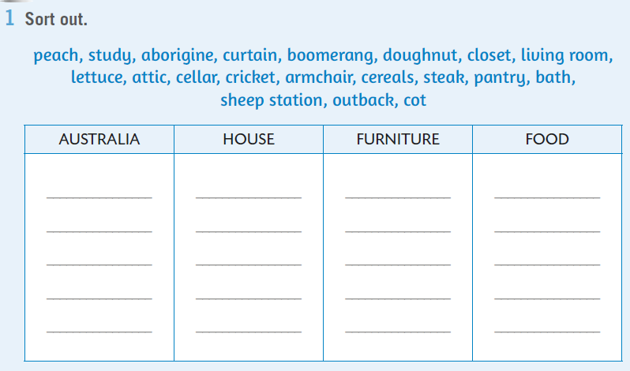
WB, page 93 .In task 1, you need to sort out the words.
aborigine
study
curtain
peach

Slide 3
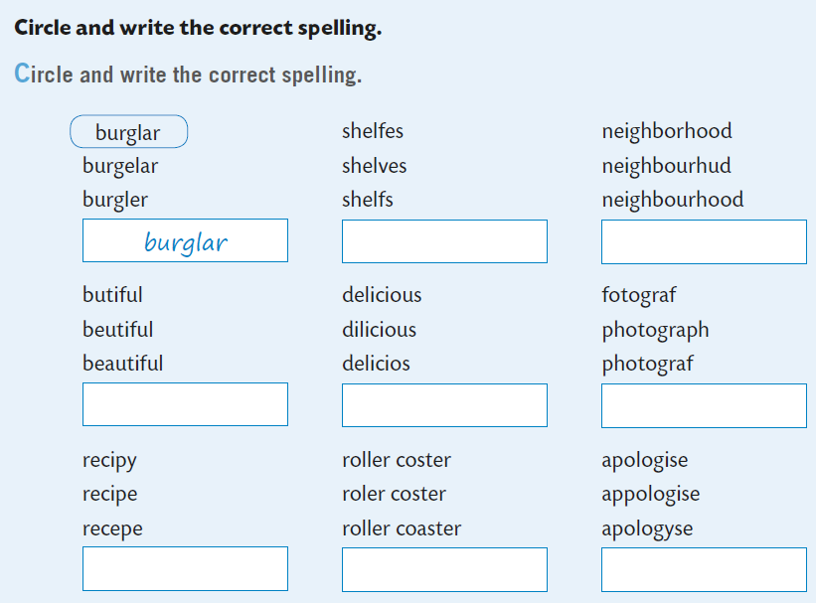

Next task deals with spelling. You have to circle and write the correct spelling.
shelves

Slide 4
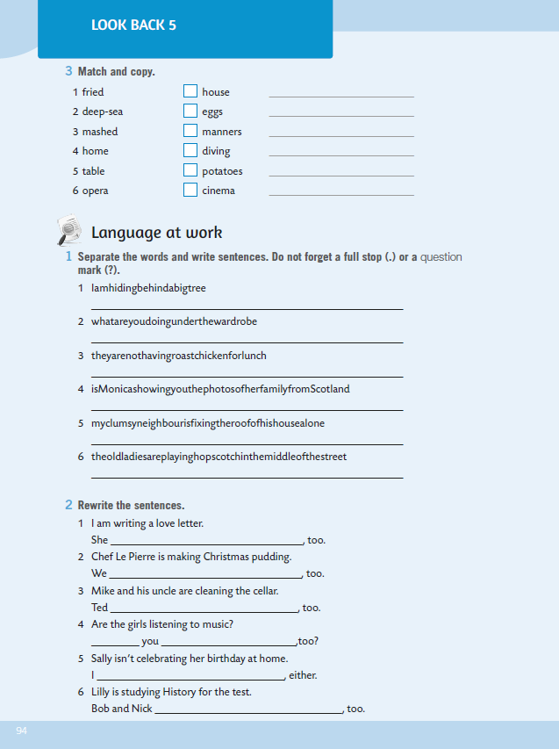
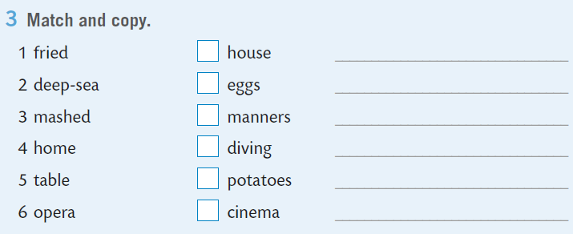
Match and copy the expressions in task 3.
fried potatoes
1
You can practice it here:
https://www.e-sfera.hr/dodatni-digitalni-sadrzaji/f2867f77-bc39-45a8-b93d-bbc1f8ded37c/assets/interactivity/kviz_7/index.html

Slide 5

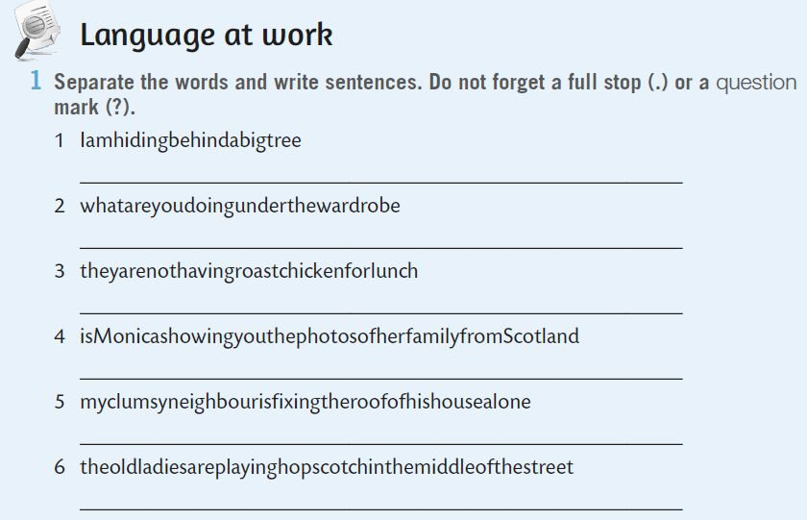
I am hiding behind a big tree.
What are you doing under the wardrobe?
Nakon što si ponovio riječi naučene u proteklom periodu vrijeme je da ponoviš i Present Continuous.
Prolistaj svoju bilježnicu i prisjeti se što si naučio o tom glagolskom vremenu, a ako ti još uvijek nešto nije jasno možeš pogledati i video na sljedećoj poveznici: https://youtu.be/rud7Aa5dNY0
Na 94. stranici radne bilježnice imaš zadatke u kojima možeš provjeriti jesi li razumio Present Simple!
Separate the words and write sentences. Do not forget a full stop (.) or a question mark (?).

Slide 6
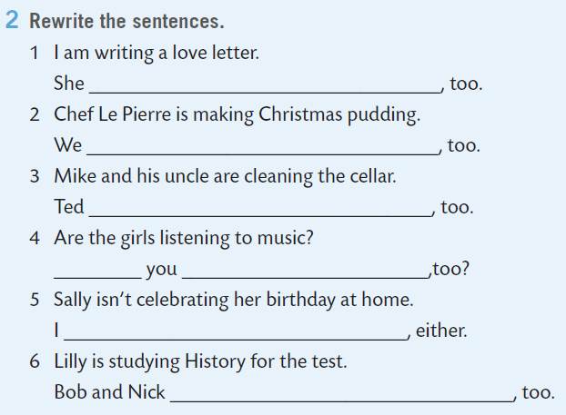
WB, p. 94. Rewrite the sentences.
is writing a love letter
are making Christmas pudding

Slide 7
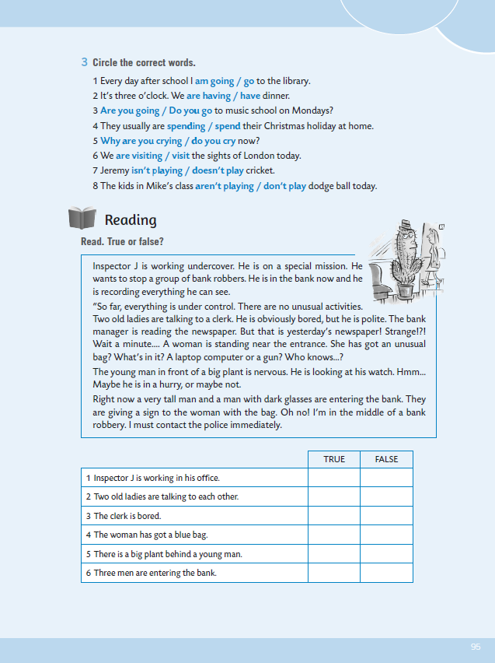
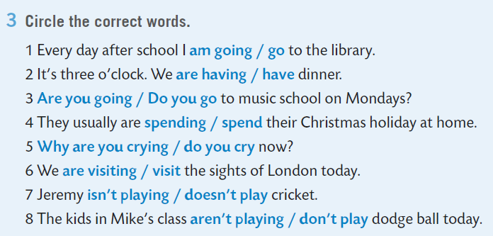
Circle the correct word.
Watch the video: https://youtu.be/Oah84WvNJy4
U prvoj rečenici si koristio Present Simple zato to se radnja događa svaki dana, tj. ponavlja se, dok si u drugoj rečenici koristio Present Continuous zato što su sada tri sata i mi sada ručamo – dakle, radnja se odvija u tom trenutku!

Slide 8
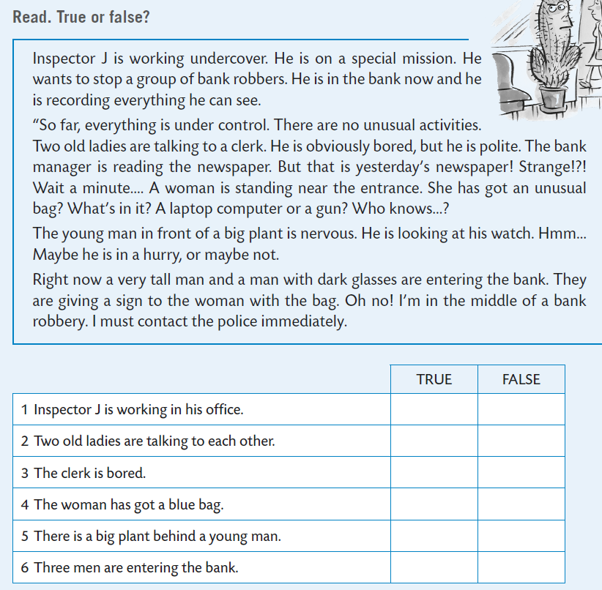
Read. True or false?
False
False

Slide 9
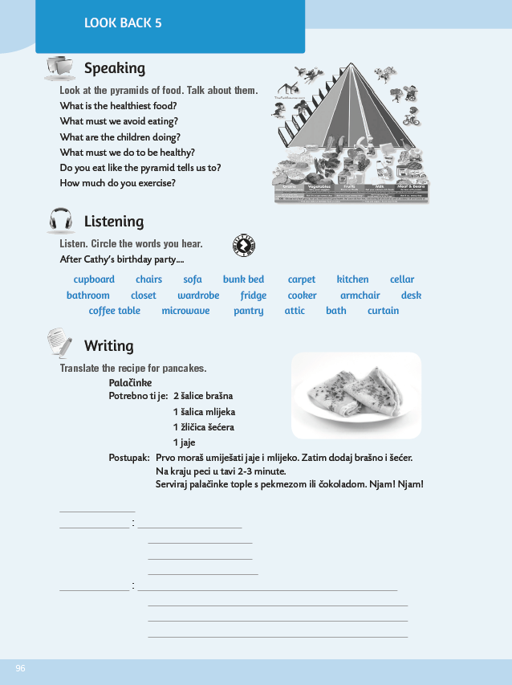
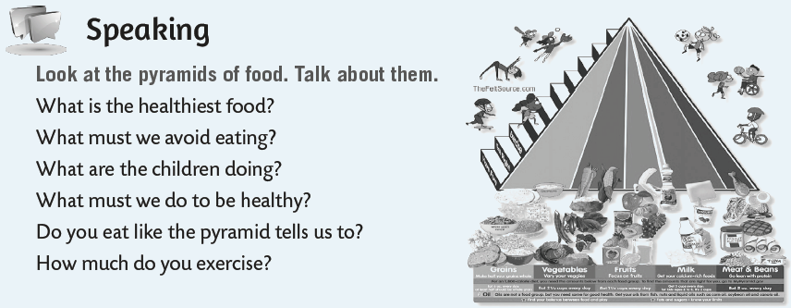
Look at the pyramid of food and think.
Write the answers in your notebook. Talk to your friend and write their ansers, too.

Slide 10

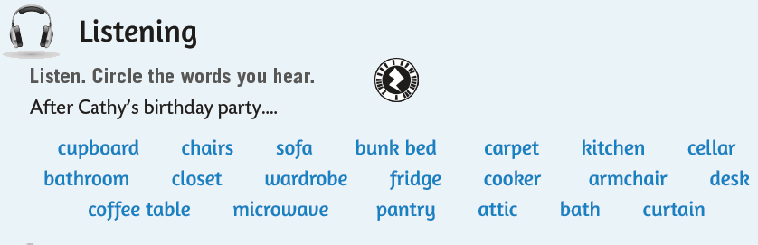
In the listening section, listen and circle the words you hear.
https://www.e-sfera.hr/dodatni-digitalni-sadrzaji/f2867f77-bc39-45a8-b93d-bbc1f8ded37c/assets/audio/look_back_5-_cathy_s_birthday.mp3

Slide 11
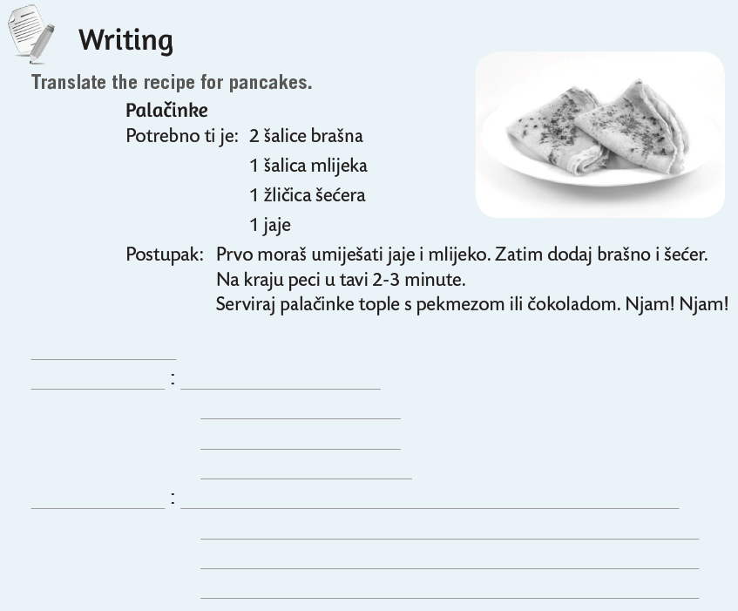
Translate the recipe for pancakes.
Use examples you have in your book and workbook.
You need
Procedure

Slide 12
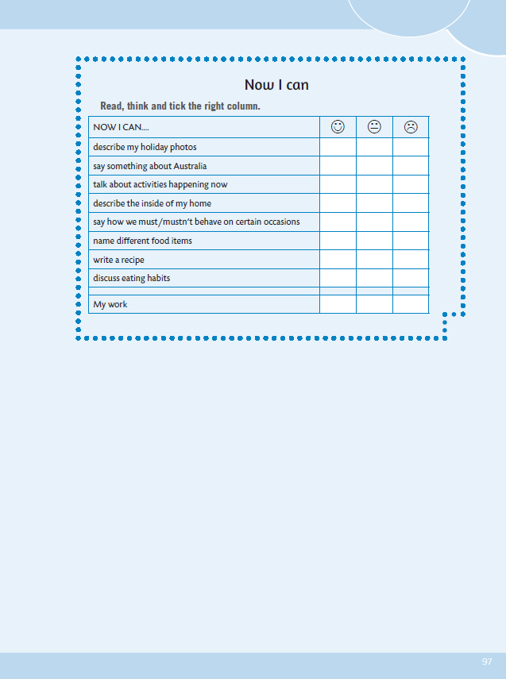
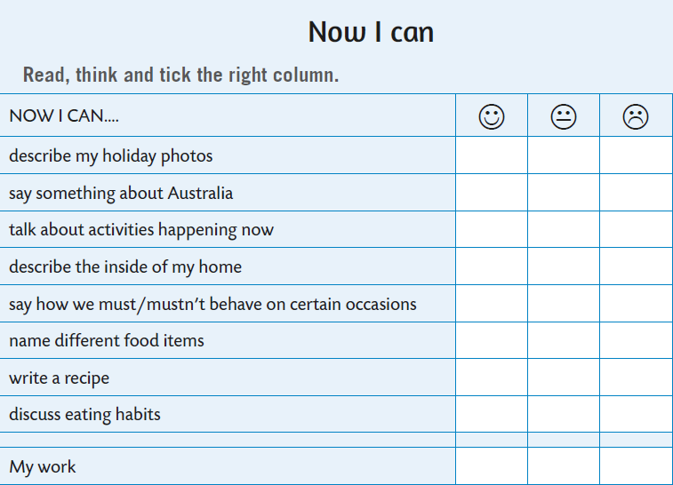



Now you can self-evaluate. Read the sentences, think and tick the right column.
- opisati fotografiju sa praznika
- reći nešto o Australiji
- razgovarati o radnjama koje se događaju upravo sada
- opisati unutrašnjost kuće
- reći kako se moramo ponašati u određenim situacijama
- imenovati različite prehrambene namirnice
- napisati recept
- raspravljati o prehrambenim navikama

